Slide 1
Give directions
Dať pokyny
(Ukázať cestu)

Slide 2
1. Pre dávanie inštrukcií a pokynov, kde sa čo nachádza, je potrebné zopakovať si predložky miesta. 2. Pre dávanie inštrukcií ako a kam sa dostať je potrebné naučiť sa frázy.

Slide 3
1. Prepositions of the place (Predložky miesta)
in - v next to - vedľa
on – na above [ƏbƏv] - vyššie
under [andƏ(r)] – pod below [bƏlov] - nižšie
in front of [in frant ov] – pred between [bitwín]–medzi dvomi
behind [bihajnd] - za

Slide 4
2. Useful phrases of giving the directions (Užitočné frázy pre udávanie smeru ako sa kam dostať.)
1. Go straight on. 3. Turn right.
[gou strejt on] [tƏrn rajt]
Choď(te) rovno. Odboč(te) vpravo.
2. Go past. 4. Turn left.
[gou pást] [tƏrn left]
Prejdi(te) okolo. Odboč(te) vľavo.

Slide 5
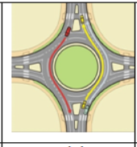
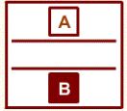
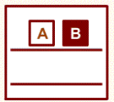
5. Go back to the roundabout.
[gou bäk tu đ raundƏbaut]
Vráť(te) sa na okruhový objazd.
6. It‘s on the left. It‘s on the right.
[ic on đ left] [ic on đ rajt]
Je to vľavo. Je to vpravo.
7. The theatre (B) is opposite the bank (A).
[đ ӨiƏtƏ(r) is opozit đ bänk]
Divadlo je oproti banke.
8. The museum (B) is next to the bank (A).
[đ mjuzijƏm is nekst tu đ bänk]
Múzeum je vedľa banky.

Slide 6
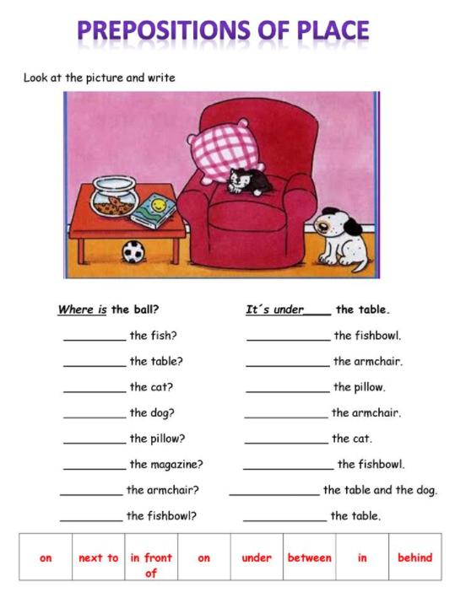

Slide 7
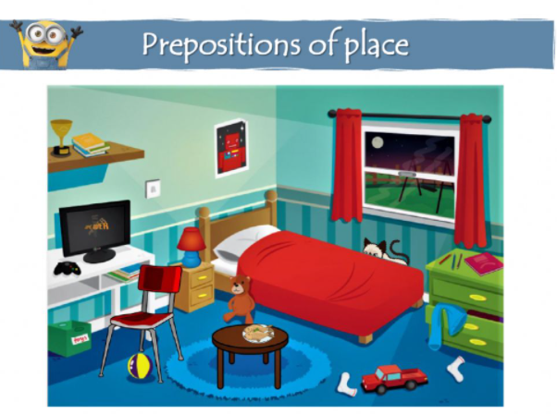

Slide 8
Choose the correct preposition according to the picture.
(Vyber správnu predložku podľa obrázka.)
1. There is a TV in / on / under the desk.
2. There are three pencils next to / opposite / under the pink notebook.
3. There is a ball behind / between / under the red chair.
4. There is a teddy bear in front of / between / on the bed.
5. There is a cat opposite / on / behind the bed.
6. There is a lamp on / in / under the bedside table.
7. There is a green toy box next to / opposite / under the desk.
8. There is a picture of red robot on / behind / under the wall.
9. There is a toy car in front of / between / on the two socks.
10. We can’t see the door. It’s opposite / between / in the window.

Slide 9
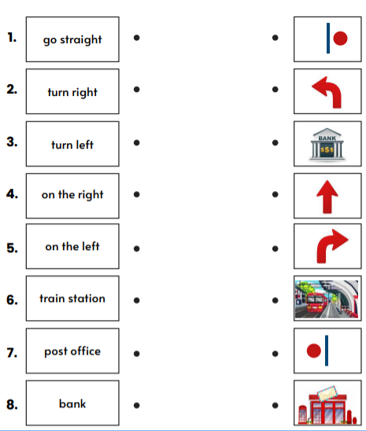
Connect the word / phrase to the correct picture.
(Spoj slovo alebo frázu so správnym obrázkom.

Slide 10
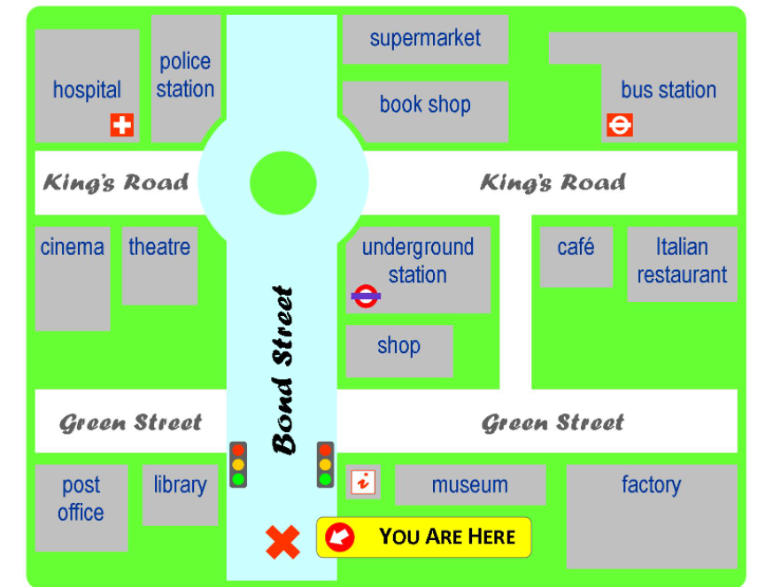
Try to give directions to your friend how to get somewhere. Work in pairs.
(Pokús sa nasmerovať kamaráta ako sa dostane niekam. Pracujte vo dvojiciach.)

